Slide 1
Anomaly detection in graphs - past, present and future.
Leman Akoglu CMU
Mary McGlohon Google
Christos Faloutsos CMU

Slide 2
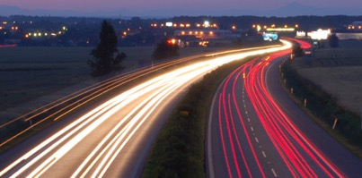
Roadmap
Introduction – Motivation
OddBall
Last 10 years
Future
Q1) definition?
Q2) automation?
Q3) next steps?

Slide 3
Future – parting thoughts
Q1) Definition of anomaly?
A) “… strange/remote/unlikely, wrt our biases/priors”
Q2) can we automate it?
A) no, but: look for better models/biases/priors
Q3) next steps?
A) cross-disciplinarity -> new+better models

Slide 4
Future – parting thoughts
Q1) Definition of anomaly?
A) “… strange/remote/unlikely, wrt our biases/priors”
Q2) can we automate it?
A) no, but: look for better models/biases/priors
Q3) next steps?
A) cross-disciplinarity -> new+better models

Slide 5
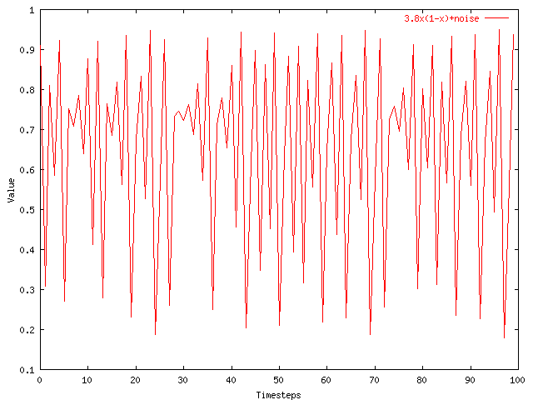
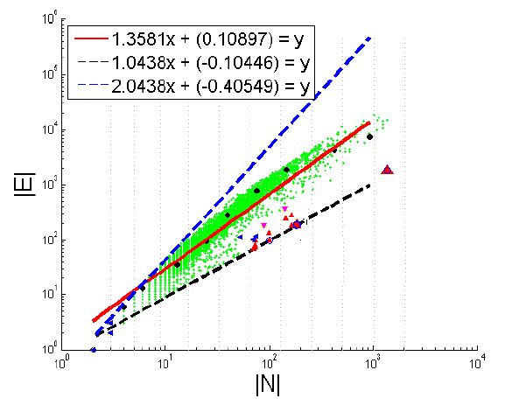
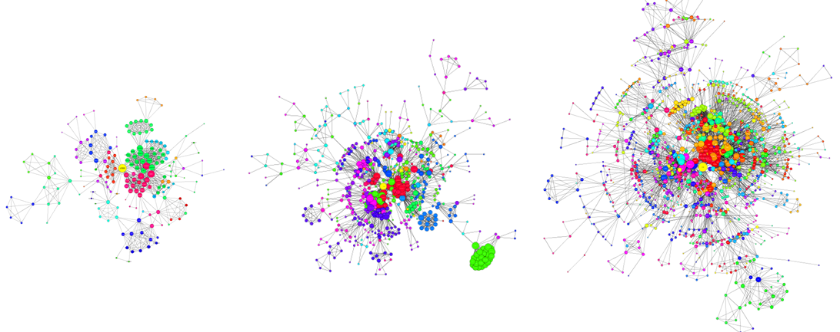
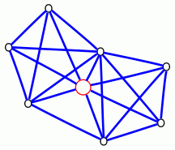
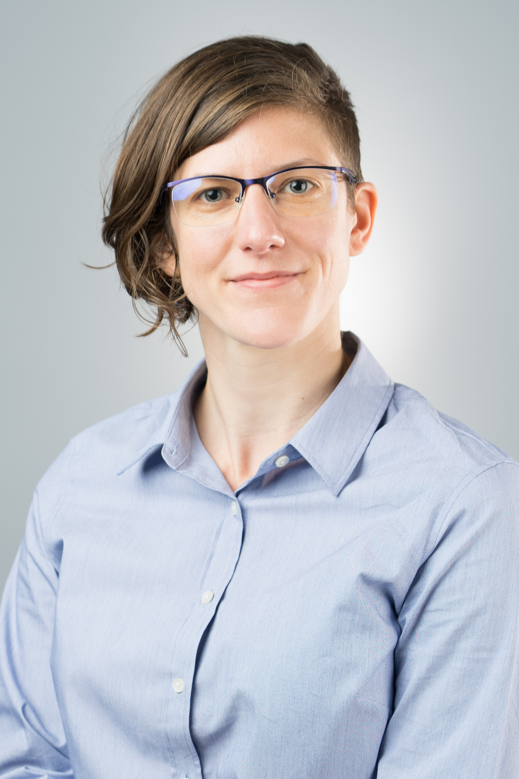
Graphs <-> points <-> time-series
time

Slide 6
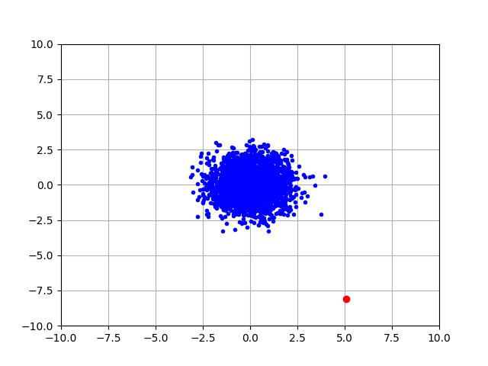
Q1) definition
“an observation which deviates so much from the other observations as to arouse suspicions that it was generated by a different mechanism”
D. M. Hawkins. Identification of outliers, volume 11. Springer, 1980.

Slide 7
Q1) definition
‘deviation from the common rule’
https://www.merriam-webster.com/dictionary/anomaly

Slide 8
Q1) definition
‘deviation from the common rule’
https://www.merriam-webster.com/dictionary/anomaly
But: How to spot rules?

Slide 9
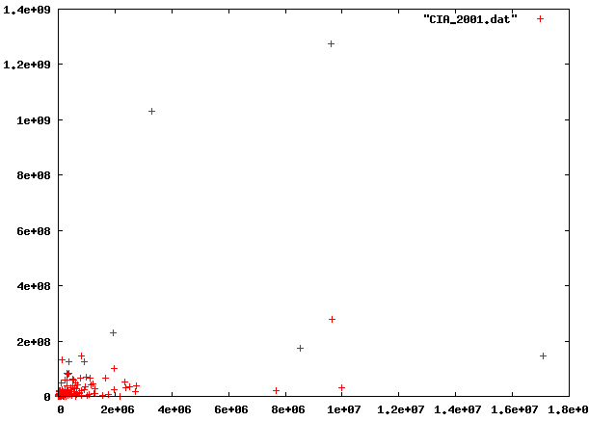
Q1: rules?

Slide 10
Q1: rules?

Slide 11
Q1: rules?
population
World countries
area

Slide 12
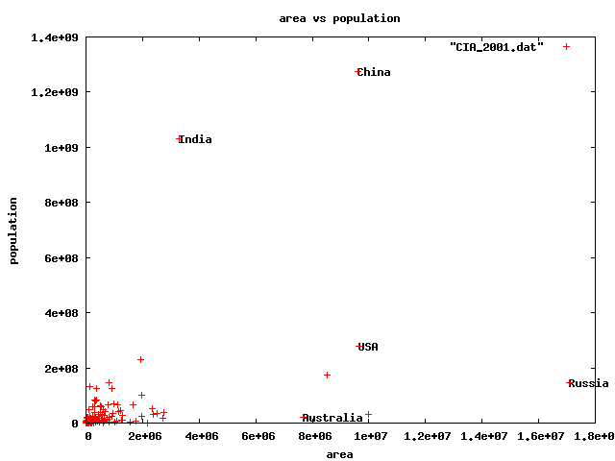
Q1) rules?
🇨🇳
🇮🇳
🇱🇷
🇷🇺
🇦🇺

Slide 13
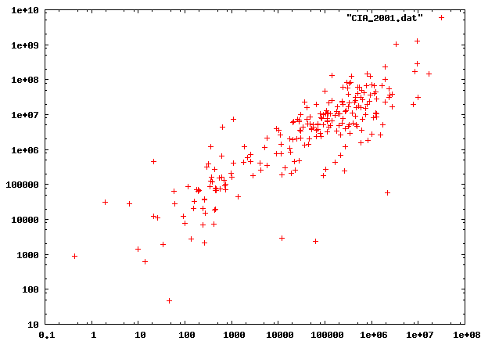
Q1) rules?

Slide 14
Q1) rules?

Slide 15
Q1) rules?

Slide 16
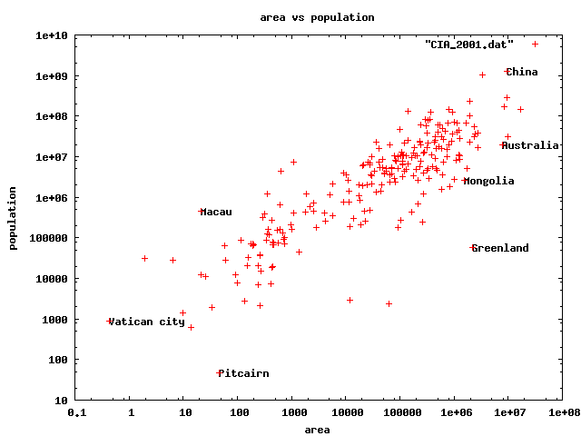
Q1) rules
0.5km²
82 football fields
47 residents(!)

Slide 17
Q1) rules?

Slide 18
Q1) definition
‘deviation from the common rule’*
https://www.merriam-webster.com/dictionary/anomaly
* Wrt our rule-types(s)/ biases/ models/ axis-scales
But: How to spot rules?

Slide 19

Q1) definition
Rule-types/
rules
anomalies

Slide 20
Roadmap
Introduction – Motivation
OddBall
Last 10 years
Future
Q1) definition?
Q2) automation?
Q3) next steps?

Slide 21
Future – parting thoughts
Q1) Definition of anomaly?
A) “… strange/remote/unlikely, wrt our biases/priors”
Q2) can we automate it?
A) no, but: look for better models/rule-types/priors
Q3) next steps?
A) cross-disciplinarity -> new+better models

Slide 22
Q2) automation?
Q2.1
patterns
Q2.2
anomalies
compression

Slide 23
Q2) automation?
Q2.1
patterns
Q2.2
anomalies
compression

Slide 24
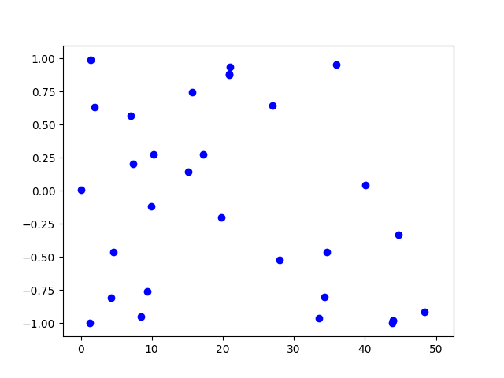
Q2.1) patterns <-> anomalies
Random?

Slide 25
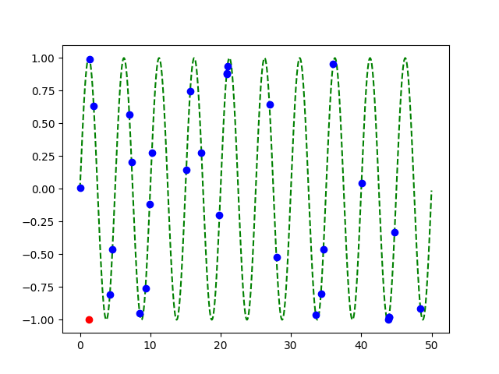
Q2.1) patterns <-> anomalies
Random?
Pattern!
+
Anomaly!

Slide 26
Q2) automation?
✓
Q2.1
patterns
Q2.2
anomalies
compression

Slide 27
Q2.2) patterns <-> compression
2 int per point
1 int per point
(plus 3 parm’s of sinusoid,
plus 2 int for outlier)

Slide 28
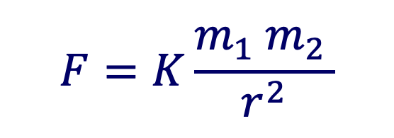
Q2.2) patterns <-> compression
Compression: @heart of science, e.g.:
$$F=K\frac{m_{1} m_{2 }}{r^{2}}$$
⬅️ Kepler ⬅️

Slide 29
compression is great – but …

Slide 30
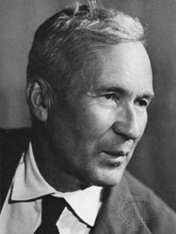
… optimal compression is undecidable!
Theorem*: for an arbitrary string x, computing its Kolmogorov complexity K(x) is undecidable
A.N. Kolmogorov
(*) E.g., [T. M. Cover and J. A. Thomas. Elements of Information Theory. John Wiley and Sons,1991, section 7.7]

Slide 31
… optimal compression is undecidable!
Theorem*: for an arbitrary string x, computing its Kolmogorov complexity K(x) is undecidable
EVEN WORSE
than NP-hard!
A.N. Kolmogorov
(*) E.g., [T. M. Cover and J. A. Thomas. Elements of Information Theory. John Wiley and Sons,1991, section 7.7]

Slide 32
… optimal compression is undecidable!
…which means there will be a chance to discover better data mining tools / models / rule-types
-> job security ☺
-> job satisfaction ☺
…

Slide 33
Roadmap
Introduction – Motivation
OddBall
Last 10 years
Future
Q1) definition?
Q2) automation?
Q3) next steps?

Slide 34
Future – parting thoughts
Q1) Definition of anomaly?
A) “… strange/remote/unlikely, wrt our biases/priors”
Q2) can we automate it?
A) no, but: look for better models/biases/priors
Q3) next steps?
A) cross-disciplinarity -> new+better models

Slide 35
Examples of models
Fractals / self-similarity
Logistic parabola (flies; covid)
Lotka-Volterra
Lorenz attractor (laser / synthetic )
Van der Pol / FitzHugh-Nagumo

Slide 36
Q3.1) models

Slide 37
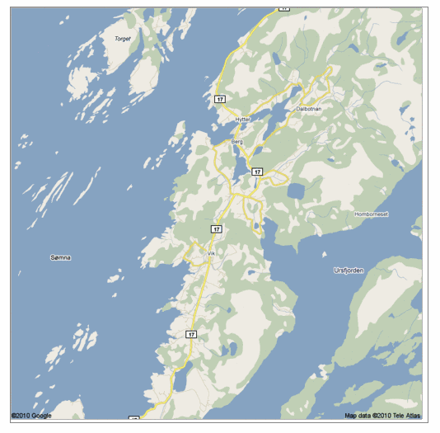
Q: Any pattern?

Slide 38
A: self similar!

Slide 39
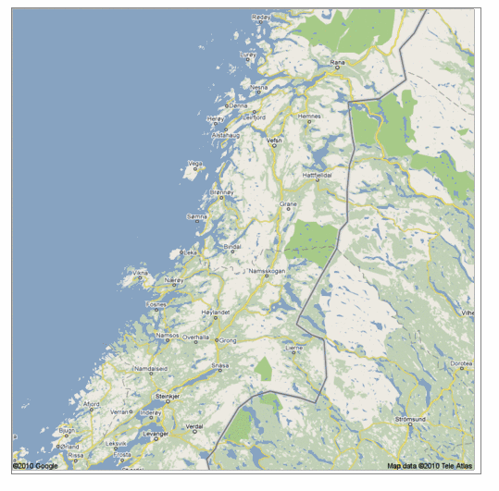
Real, self similar dataset

Slide 40
Real, self similar dataset

Slide 41
Real, self similar dataset

Slide 42
Real, self similar dataset

Slide 43
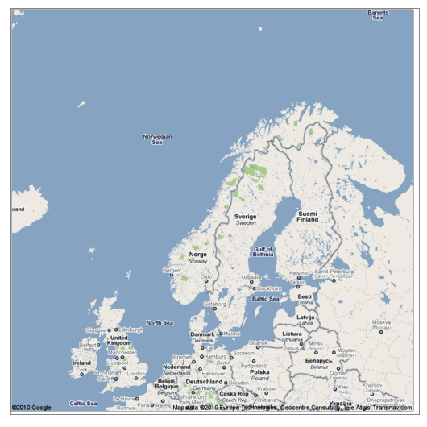
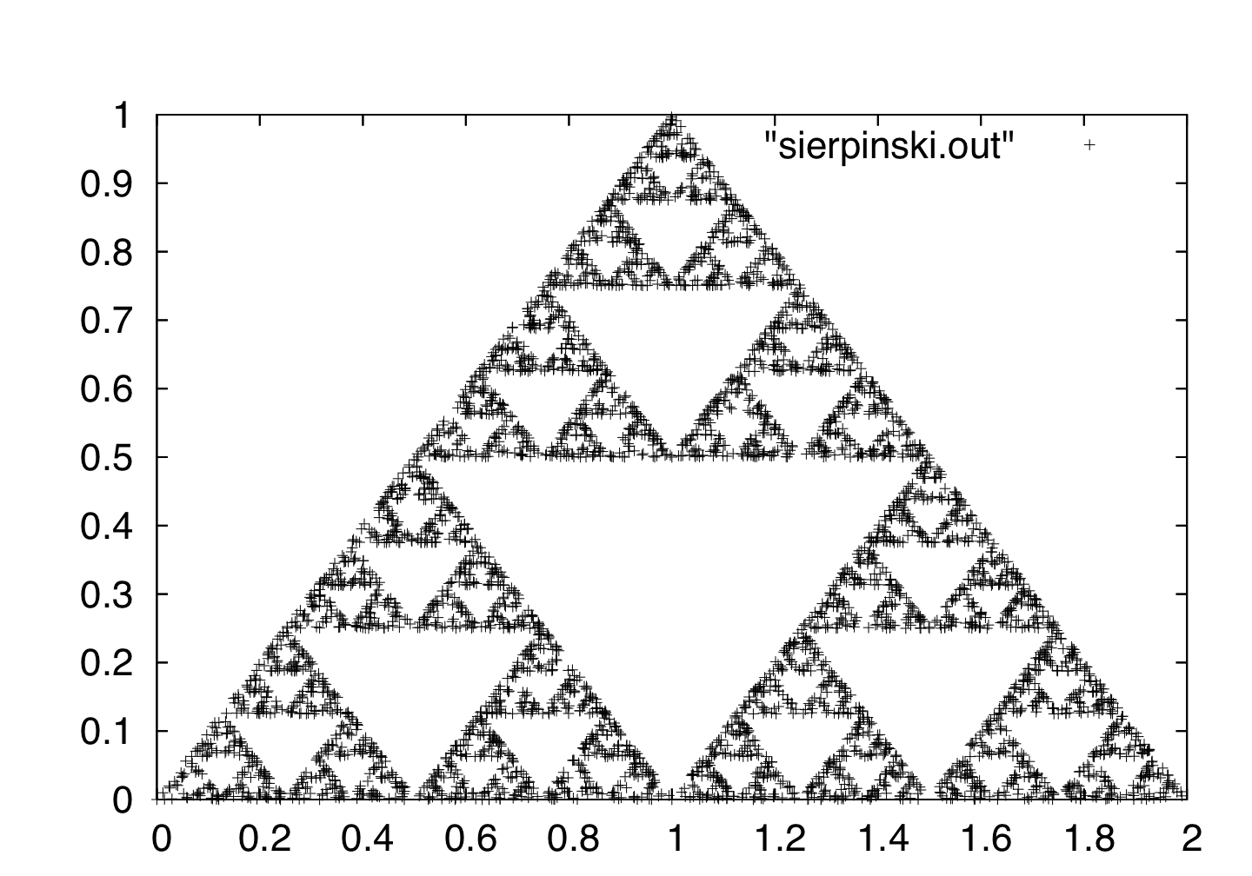
the red is true
origin: Norway
but most other coastlines are ‘self-similar’, too!

Slide 44
the red is true
origin: Norway
but most other coastlines are ‘self-similar’, too!
B. Mandelbrot
math.yale.edu
en.wikipedia.org

Slide 45
Q: Fractals and Graphs?

Slide 46
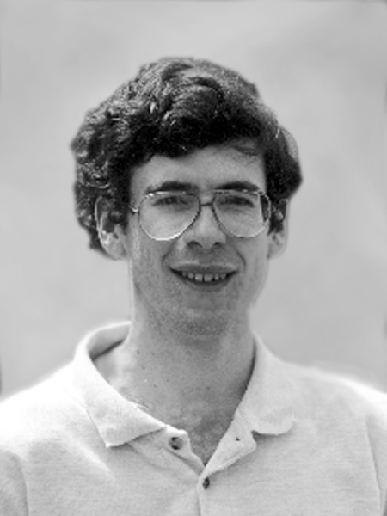
Fractals and Graphs
A: RMAT/Kronecker generators
D. Chakrabarti
J. Leskovec
J. Kleinberg
R-MAT: A Recursive Model for Graph Mining,
by D. Chakrabarti, Y. Zhan and C. Faloutsos,
SDM 2004, Orlando, Florida, USA
Realistic, Mathematically Tractable Graph Generation
and Evolution, Using Kronecker Multiplication,
by J. Leskovec, D. Chakrabarti, J. Kleinberg,
and C. Faloutsos, in PKDD 2005, Porto, Portugal

Slide 47
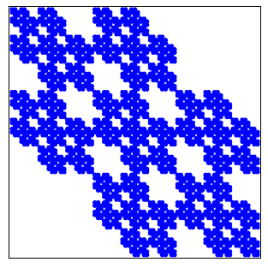
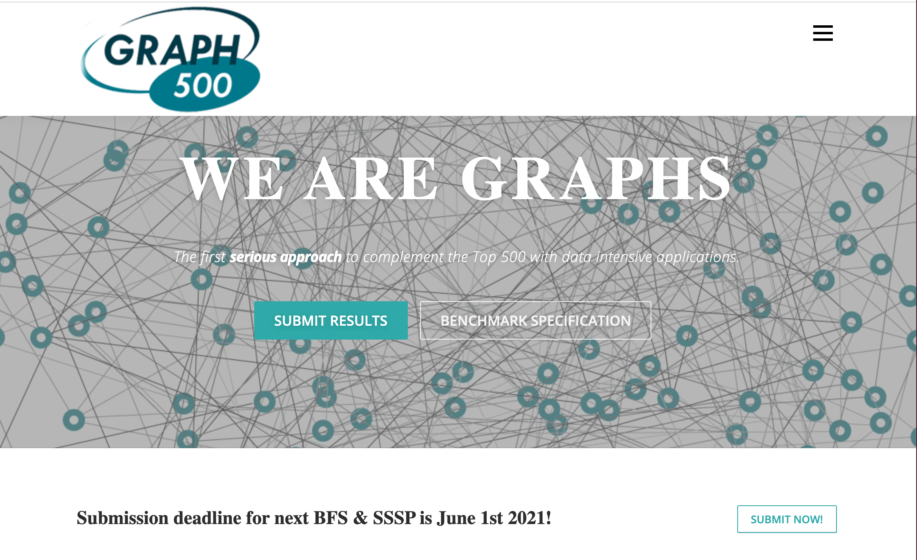
Kronecker Graphs
KDD dissertation award
[J. Leskovec, 2009]
PKDD test of time award, 2015
https://graph500.org/

Slide 48
Examples of models
✓
Fractals / self-similarity (Norway; Kronecker)
Logistic parabola (flies; covid)
Lotka-Volterra
Lorenz attractor (laser / synthetic )
Van der Pol / FitzHugh-Nagumo

Slide 49
Q3.1) models?
Value
Time

Slide 50

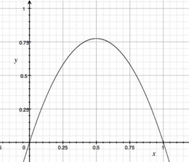
A3.1) Logistic parabola
royalsociety.org
Models population of flies [R. May/1976]
Logistic map
Time-series plot
Time t
Notes:
x_{t+1} = a x_t \cdot \left( 1-x_t \right )

Slide 51
A3.1) Logistic parabola
royalsociety.org
Models population of flies [R. May/1976]
Logistic map
~ SI virus prop. model
~ Bass equation (market penetration)
Special case of Lotka-Volterra
[COVID-19: SIR]
Notes:
x_{t+1} = a x_t \cdot \left( 1-x_t \right )

Slide 52

Q3) How can we find better models?
A3) Domain experts / cross-disciplinarity

Slide 53
Settings & Graphs
Set up | Method | Directed {Y, N} | Weighted {Y, N} | Multi-edges {Y, N} | Edge Attr. {Y, N} | Node Attr. {Y, N} | Time {Y, N}
N O D E | OddBall | 0 | 1 | 0 | 0 | 0 | 0
 | FraudEagle | 0 | 0 | 0 | 1 | 0 | 0
 | Speagle | 0 | 0 | 0 | 1 | 0.5 | 0
 | FocusCO | 0 | 0 | 0 | 0 | 1 | 0
S U B Gr. | Fraudar | 0 | 0 | 0 | 0.5 | 0.5 | 0
 | CopyCatch | 0 | 0 | 0 | 0 | 0 | 1
 | AMEN | 0 | 0 | 0 | 0 | 1 | 0
G R A P H | StreamSpot | 0 | 0 | 0 | 0.5 | 0.5 | 1
 | SpotLight | 1 | 0 | 0 | 0 | 0 | 1
 | ChangeDAR | 0 | 0 | 0 | 1 | 1 | 1
 | CODEtect | 1 | 0 | 1 | 0 | 0.5 | 0

Slide 54
Future – parting thoughts
✓
Q1) Definition of anomaly?
A) “… strange/remote/unlikely, wrt our biases/priors”
Q2) can we automate it?
A) no, but: look for better models/biases/priors
Q3) next steps?
A) cross-disciplinarity -> new+better models
✓
✓

Slide 55







Thanks
Disclaimer: All opinions are mine; not necessarily reflecting the opinions of the funding agencies
Thanks to: NSF IIS-0705359, IIS-0534205,
CTA-INARC; Yahoo (M45), LLNL, IBM, SPRINT, Google, INTEL, HP, iLab

Slide 56
Thanks
Prof. R.K. Agrawal
Prof. P. Krishna Reddy
Prof. Jaideep Srivastava

Slide 57
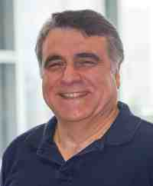
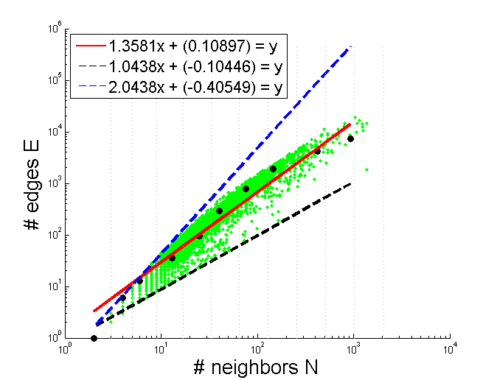
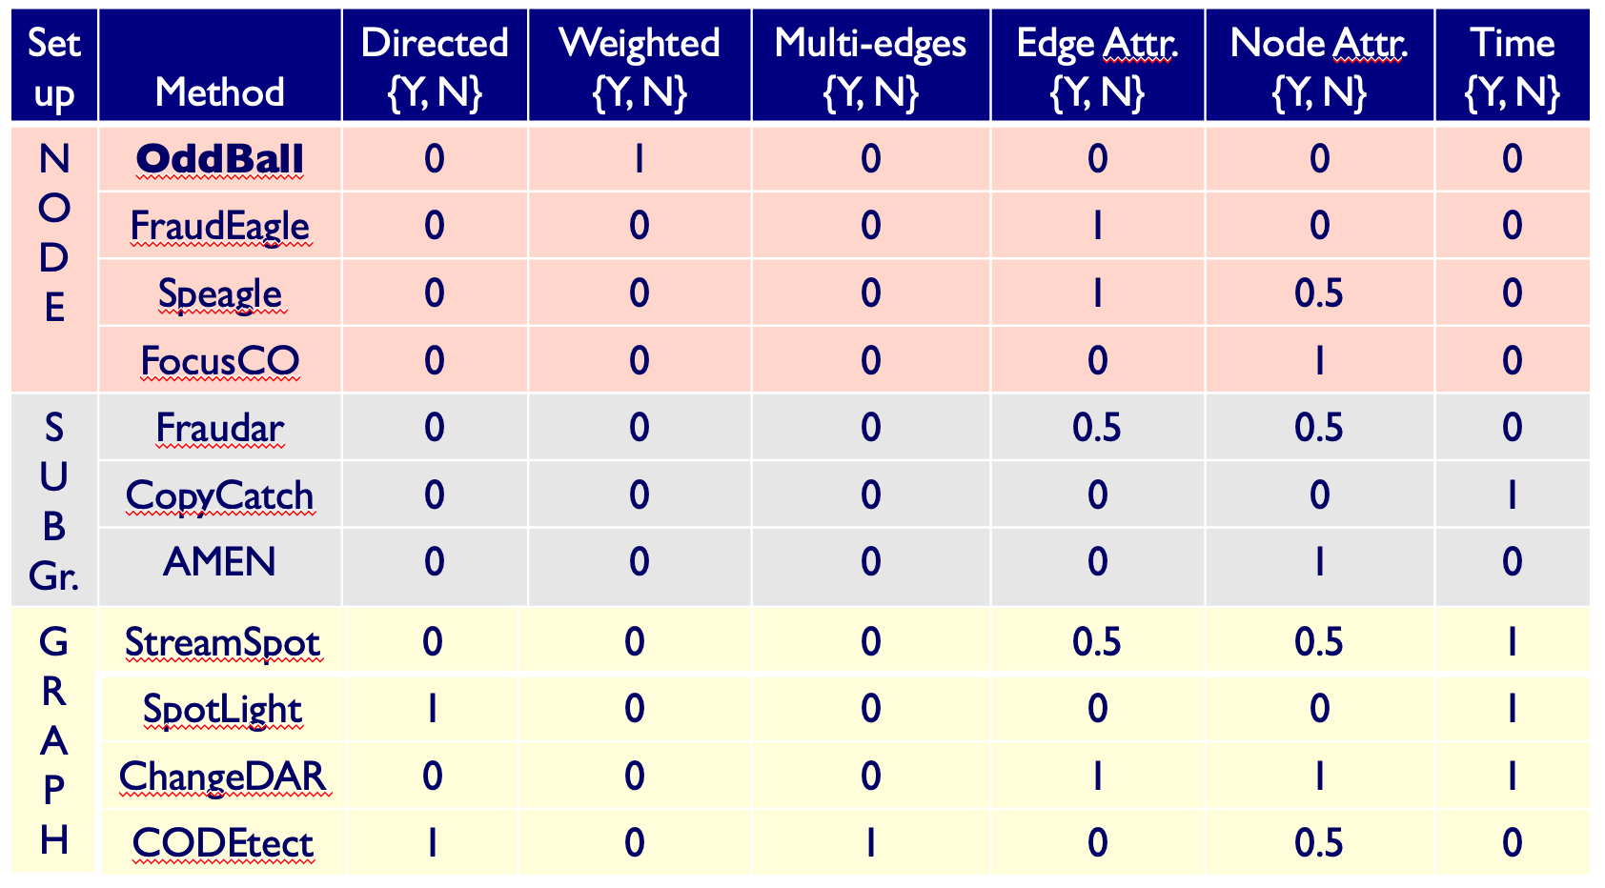
Conclusions
Patterns <-> anomalies
Rep. learning
Cross-disciplinarity

Slide 58
Conclusions
Thank you!
Patterns <-> anomalies
Rep. learning
Cross-disciplinarity

